Slide 1
Integrating Concepts in Biology
PowerPoint Slides for Chapter 13:
Cells at the Organismal Level
by
A. Malcolm Campbell, Laurie J. Heyer, and Chris Paradise

Slide 2

Front art piece UN13.1
Notes:
Front art piece Front art piece UN13.1 Muscles grow in response to consistent exercise and use, a condition known as hypertrophy. Fire is a disturbance to which some species of trees living in savanna ecological systems have adapted.

Slide 3
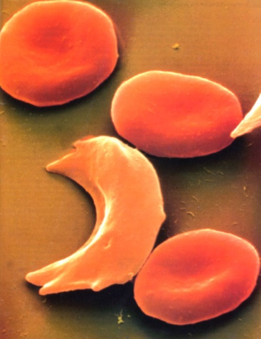
Figure 13.1
Notes:
Figure 13.1 Several normal and one sickled red blood cell.

Slide 4
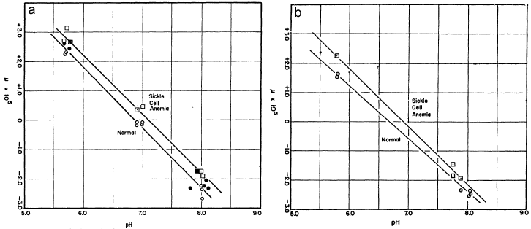
Figure 13.2
Notes:
Figure 13.2 Plots of boundary layer movement at different pHs for hemoglobins bound to carbon monoxide (a) and unbound (b). The y-axis represents a measure of movement, relative to the starting position of 0 of the boundary layer. Squares are for data from sickle-cell anemia patients and circles are for normal patients. Open circles and squares represent data from experiments without dithionite ion and filled circles and squares represent data from experiments with dithionite ion. The upper line in each graph represents the best fit line for sickle-cell hemoglobin data, and the lower line represents the best fit line for normal hemoglobin.

Slide 5
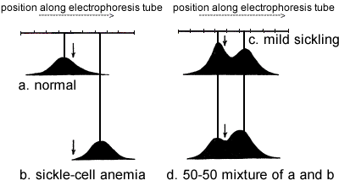
Figure 13.3
Notes:
Figure 13.3 The distribution pattern of hemoglobin represented as scanning diagrams of hemoglobin from (a) normal individuals, (b) individuals with sickle cell anemia, (c) individuals with the mild form of sickling, and (d) an artificial mixture of hemoglobin from normal and sickle-cell anemia individuals at pH 6.9. Each peak represents a distinct band and the arrows in each figure represent the line of no movement.

Slide 6

Figure BME 13.1.1
Notes:
Figure BME 13.1.1. 50-50 mixture broken down into two component curves.

Slide 7
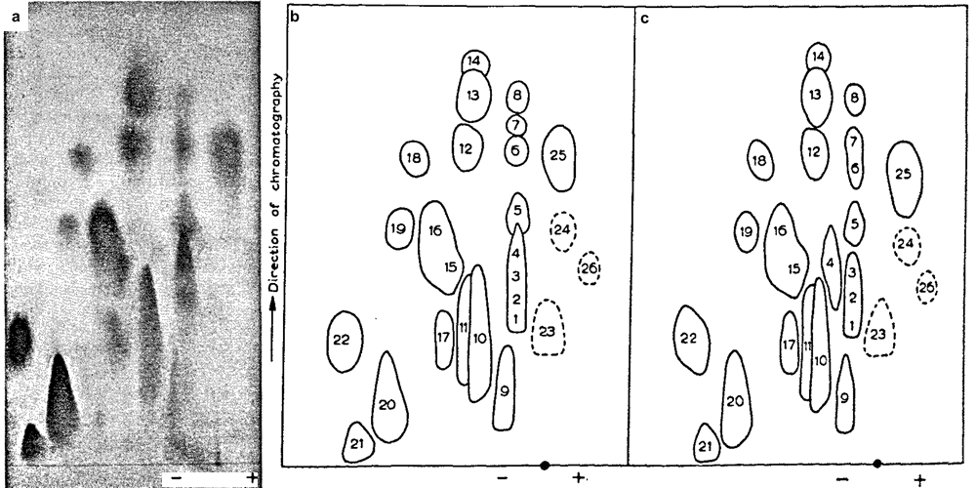
Figure 13.4
Notes:
Figure 13.4 Peptide fingerprint of normal hemoglobin (a) and tracings of (b) normal and (c) sickle-cell hemoglobin fingerprints digested in trypsin. The horizontal axis shows the separation by charge from electrophoresis and the vertical axis shows the separation by molecular size from chromatography. The black dot on the horizontal axis in panels b and c indicate the starting position of the peptide mixture. Numbers were arbitrarily set for normal hemoglobin and then blotches were paired for sickle-cell hemoglobin peptides.

Slide 8
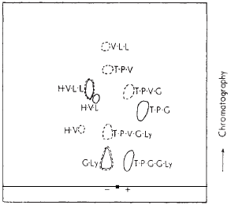
Figure 13.5
Notes:
Figure 13.5 Fingerprint of hemoglobin peptide 4 in Figure 13.4. The horizontal axis is the electrophoretic axis, with the black square representing the starting position of the peptide mixture. Normal (solid traces) and sickle-cell (dashed traces) peptide fragments were run separately and superimposed on this tracing. H = histidine, V = valine, L = leucine, T = threonine, P = proline, G = glutamic acid, Ly = lysine.

Slide 9
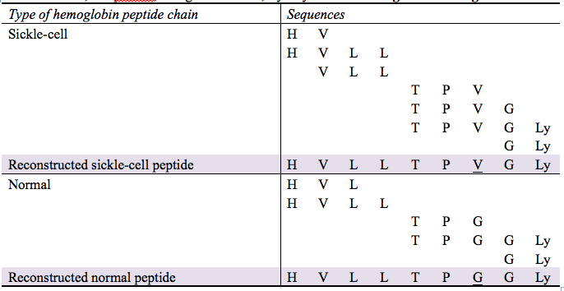
Table 13.1. Amino acid sequence alignment for the peptide hemoglobin chain #4 from Figure 13.4, reconstructed from peptide fragments in Figure 13.5. H = histidine, V = valine, L = leucine, T = threonine, P = proline, G = glutamic acid, Ly = lysine.
Notes:
Table 13.1. Amino acid sequence alignment for the peptide hemoglobin chain #4 from Figure 13.4, reconstructed from peptide fragments in Figure 13.5. H = histidine, V = valine, L = leucine, T = threonine, P = proline, G = glutamic acid, Ly = lysine. From Ingram 1957 Figure 2.

Slide 10
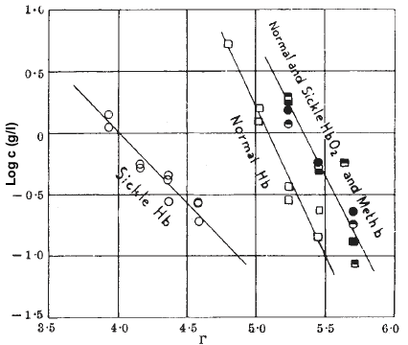
Figure 13.6
Notes:
Figure 13.6 Average measures of yucca plant response as a function of pollen quantity and source. White bars represent pollen from self, striped bars represent pollen from a single other plant, and shaded bars represent pollen from multiple other plants. Error bars are 1 standard error. a. Percent seed set is the percentage of fertile seeds out of total number of seeds. b. Percentage of germinating seeds out of total selected for planting. c. Biomass of seedlings.

Slide 11
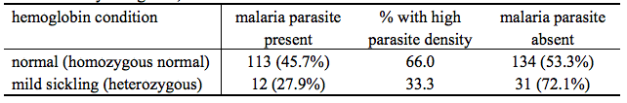
Table 13.2. Incidence of the malaria parasite in blood of normal and sickle-cell children from a small community in Uganda, Africa.
Notes:
Table 13.2. Incidence of the malaria parasite in blood of normal and sickle-cell children from a small community in Uganda, Africa.

Slide 12
Figure 13.7
Notes:
Figure 13.7 The 15 exons of the gene that encodes the FUS/TLS protein, along with the corresponding protein regions and the positions of the mutations. The amino acids in positions 514 to 526 (exon 15) of the wild type FUS/TLS protein are shown in black letters. The mutations are shown above each position in red. S,Y,Q,G–rich denotes a region rich in the amino acids serine, tyrosine, glutamine, and glycine; G-rich and RGG-rich regions are enriched in either glycine and arginine-glycine-glycine, respectively.

Slide 13
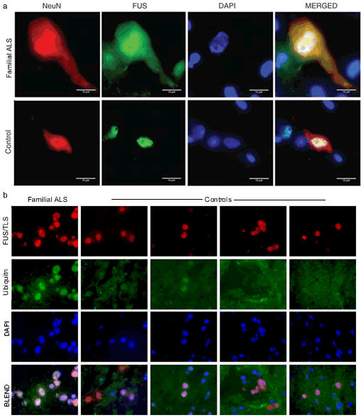
Figure 13.8
Notes:
Figure 13.8 a. Immunostaining of spinal cord from a familial ALS patient (top row) compared to a control (bottom). Staining patterns are shown individually for NeuN (red), FUS/TLS (green), and nuclei (blue), and the three are merged in the right column. DAPI, 4´,6´-diamidino-2-phenylindole stains DNA. Scale bars, 10 mm. b. Staining patterns are shown individually for FUS/TLS (red), ubiquitin (green), and nuclei (blue), and the three are merged in the bottom row. Ubiquitin immunostaining is shown for one patient with familial ALS and compared to four control individuals. Calibration bar = 20 um.

Slide 14
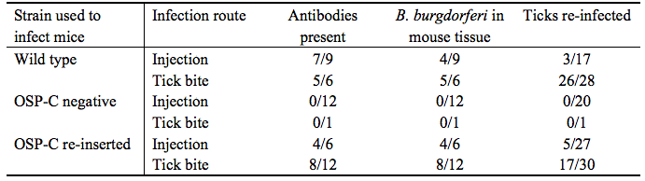
Table 13.3 Numbers of mice and ticks infected with the indicated strain of B. burgdorferi. Numerator indicates number of mice injected with a particular strain exhibiting the quality; denominator is sample size of mice or ticks. The final column is the number of ticks that were re-infected by feeding on mice that had been infected in the experiment.
Notes:
Table 13.3 Numbers of mice and ticks infected with the indicated strain of B. burgdorferi. Numerator indicates number of mice injected with a particular strain exhibiting the quality; denominator is sample size of mice or ticks. The final column is the number of ticks that were re-infected by feeding on mice that had been infected in the experiment. From Grimm et al. 2004 Table 1.

Slide 15
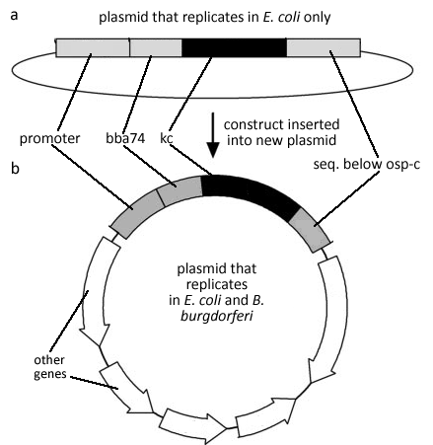
Figure 13.9
Notes:
Figure 13.9 Construction of the plasmid to test how neutrophils affect invasion of B. burgdorferi. BBA74 is an outer membrane protein in B. burgdorferi, kc is the gene that encodes chemokine KC, and seq. below osp-c is the 262-base sequence below OSP-C encoding region in B. burgdorferi.

Slide 16
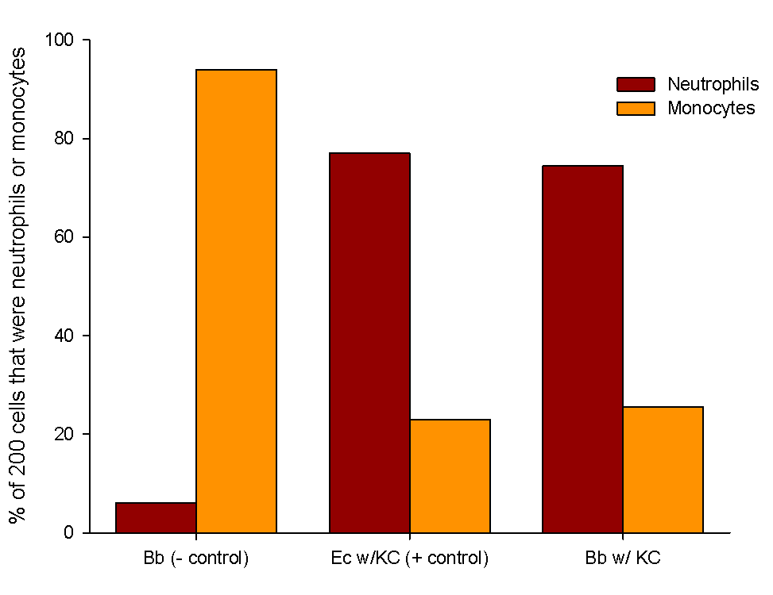
Figure 13.10
Notes:
Figure 13.10 KC activity of cell culture supernatants. The first 200 leucocytes observed in each sample were identified as either neutrophils or monocytes, and percentage shown is the overall percentage for all mice sampled. Bb = Borrelia burgdorferi, Ec = E. coli, KC = chemokine.

Slide 17
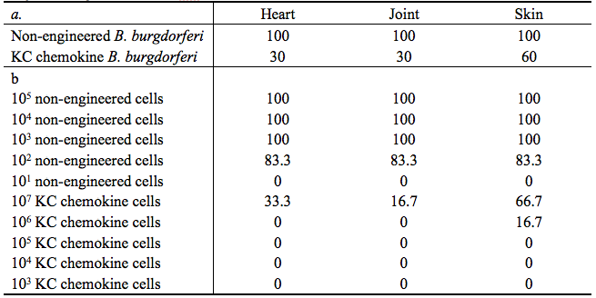
Table 13.4 a. Percentages of tissues from ten mice injected with either non-engineered or genetically engineered B. burgdorferi that showed active bacterial infections 30 days after injection. b. Percentages of tissues from six mice injected with a particular dose of either non-engineered or genetically engineered B. burgdorferi that showed active bacterial infections 30 days after injection.
Notes:
Table 13.4 a. Percentages of tissues from ten mice injected with either non-engineered or genetically engineered B. burgdorferi that showed active bacterial infections 30 days after injection. b. Percentages of tissues from six mice injected with a particular dose of either non-engineered or genetically engineered B. burgdorferi that showed active bacterial infections 30 days after injection.

Slide 18
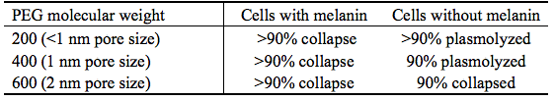
Table 13.5 Response of rice blast infection cells when exposed to concentrated solutions of polyethylene glycol (PEGs) polymers of different mean molecular weights.
Notes:
Table 13.5 Response of rice blast infection cells when exposed to concentrated solutions of polyethylene glycol (PEGs) polymers of different mean molecular weights. Data from Howard et al. 1991 text.

Slide 19
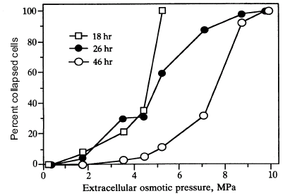
Figure 13.11
Notes:
Figure 13.11 Infection cells were grown in water for either 18, 26, or 46 hours. After that time, the water was replaced with various concentrations of a large molecule PEG, which created a variety of external pressures. After 10 minutes of exposure the cells were examined for cell collapse.

Slide 20
Figure 13.12
Notes:
Figure 13.12 Penetration as a function of (a) incubation time and (b) extracellular osmotic pressure. Numbers 1-6 in both panels indicate the Mylar substrate, with lower numbers being the softer substrates.

Slide 21
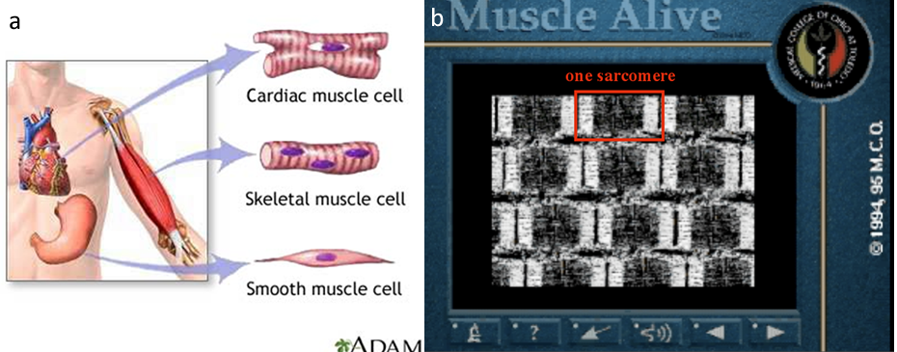
Figure 13.13
Notes:
Figure 13.13 Muscle anatomy and structure. (a) The three types of vertebrate muscle cells, a cardiac muscle cell (top), a skeletal, or striated, muscle cell (middle), and a smooth muscle cell (bottom). Note that the skeletal muscle cell has multiple nuclei, while the other types have only one nucleus per cell. (b) Image from a movie of a skeletal muscle contracting which you can view online at WileyPlus.

Slide 22
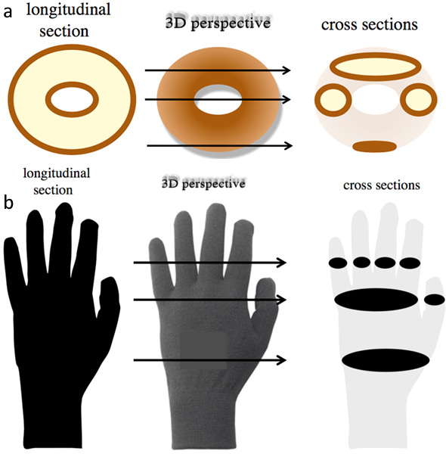
Figure 13.14
Notes:
Figure 13.14 Visualizing 3D objects when cut at different angles. (a) A doughnut is easily identified when viewed from above. Longitudinal section is easy but cross sections are challenging; arrows show where the cross-sections were made. (b) A left glove viewed in longitudinal and three cross sections.

Slide 23
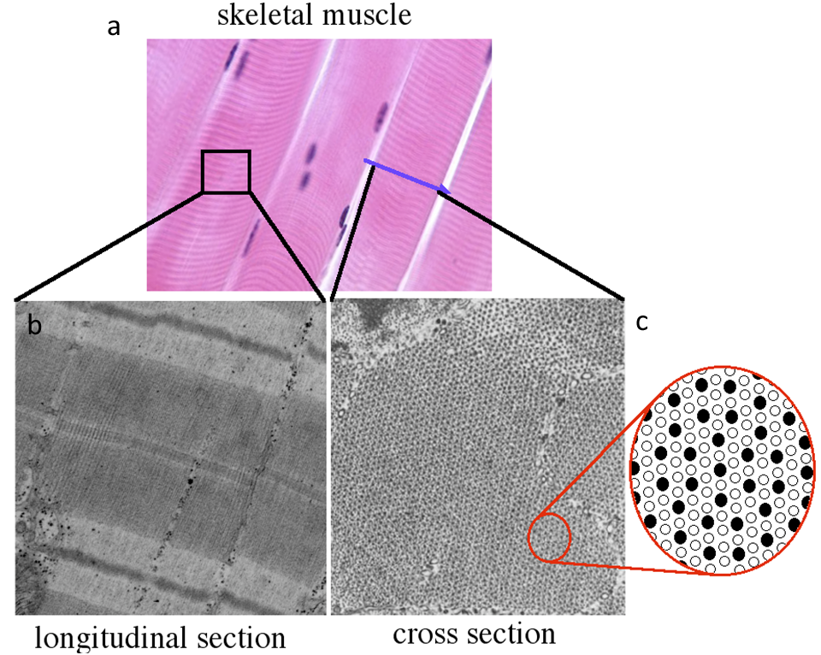
Figure 13.15
Notes:
Figure 13.15 Skeletal muscle viewed from different perspectives. a) Viewed from above by light microscopy, muscle cells are easy to identify. Blue arrow marks the location of the cross-section in panel c). Electron micrographs of (b) longitudinal and (c) cross sections of skeletal muscles.

Slide 24
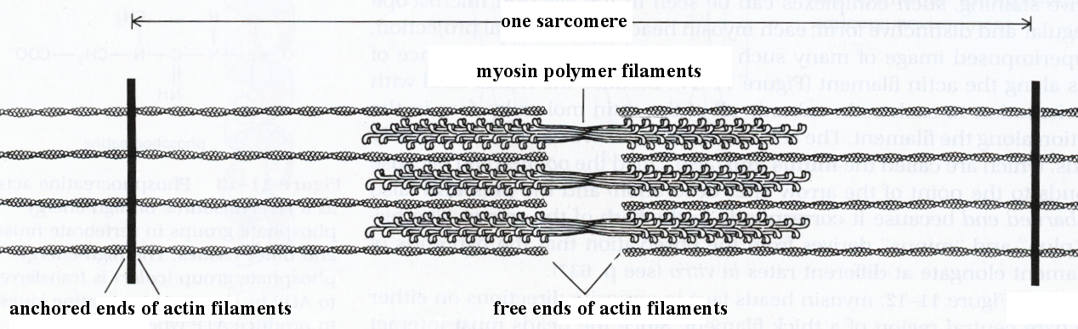
Figure 13.16
Notes:
Figure 13.16 Actin and myosin interactions provide contractile function. A sarcomere is the length of a contractile unit that spans from one actin anchor to the next. Squint your eyes to see the light and dark bands of the sarcomere.

Slide 25
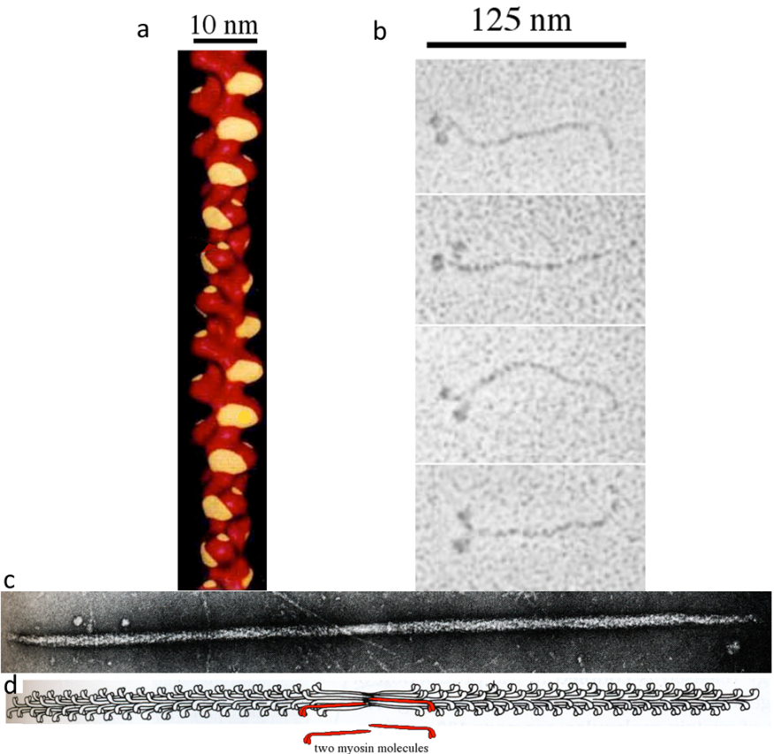
Figure 13.17
Notes:
Figure 13.17 Actin and myosin molecules from skeletal muscle. a) Molecular model of red actin polymer with myosin binding-site highlighted yellow. b) Electron micrographs of four myosin monomers. c) Myosin polymer electron micrograph. d) Line drawing of molecule in panel c; two myosin monomers colored red.

Slide 26
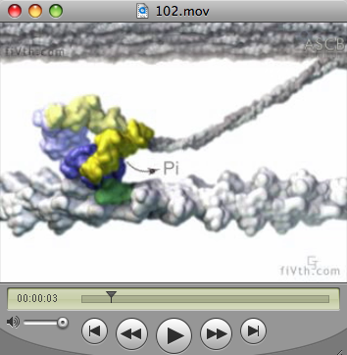
Figure 13.18
Notes:
Figure 13.18 Screen shots from myosin movement movie. Screen shot of movie showing myosin molecule using ATP to pull an actin filament. View the full movie at WileyPlus.

Slide 27
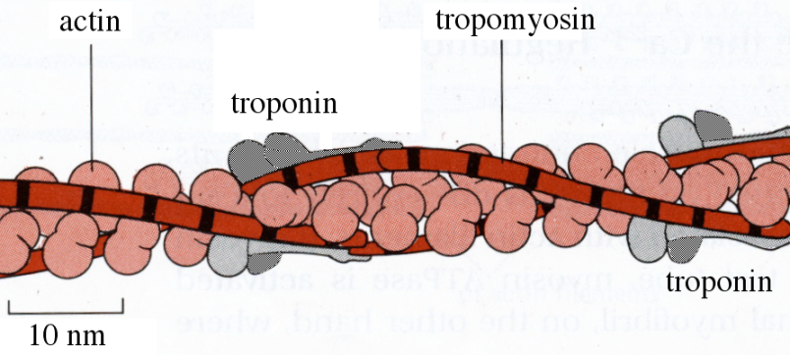
Figure 13.19
Notes:
Figure 13.19 Actin-binding proteins regulate muscle contraction. Actin filaments are covered by long tropomyosin fibers and regularly spaced troponin molecules. Troponin binds calcium and troponin blocks myosin binding sites on actin. See movie online to see how calcium affects myosin binding to actin. (see http://www.bio.davidson.edu /misc/movies/tropotropo.mov for sample animation).

Slide 28
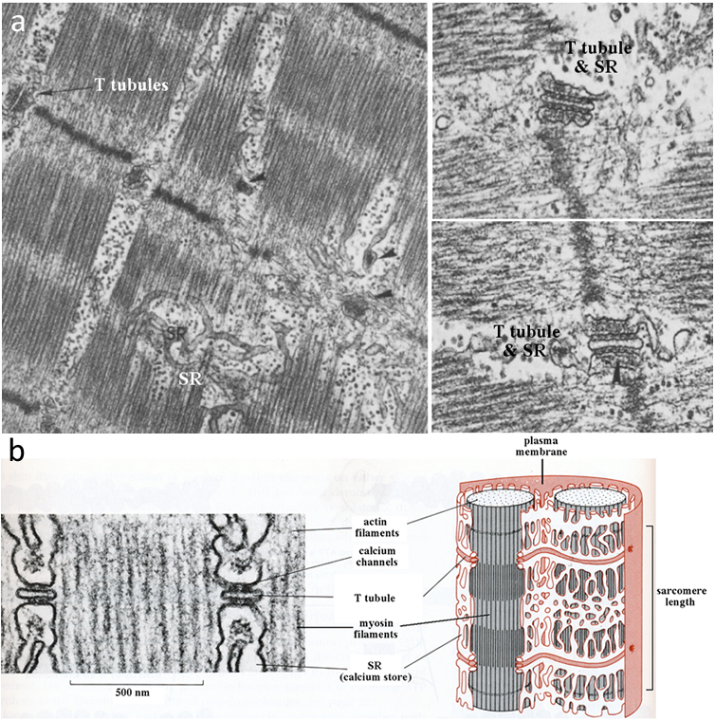
Figure 13.20
Notes:
Figure 13.20 Membrane network surrounds all sarcomeres. a) Plasma membrane extensions called T tubules surround all sarcomeres and sarcoplasmic reticulum (SR) abuts each T tubule on both sides. b) Summary images of sarcomere and membrane network that facilitates stimulation and contraction of muscle cells.

Slide 29
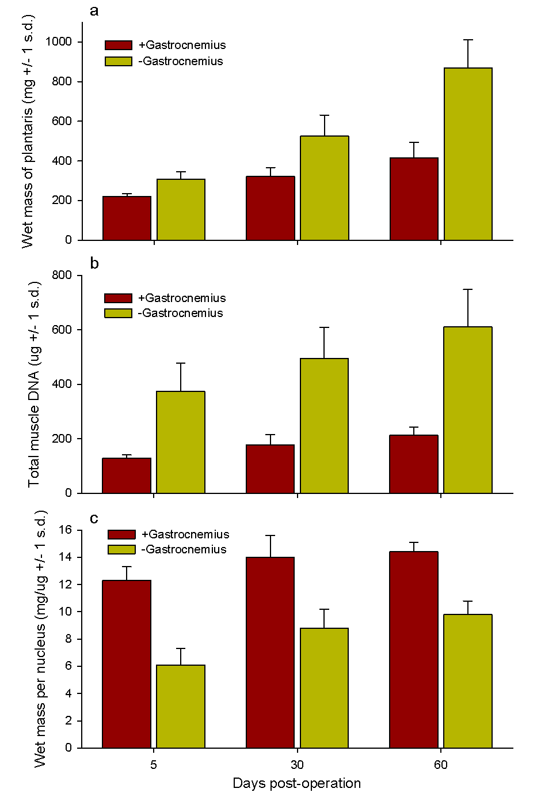
Figure 13.21
Notes:
Figure 13.21 Effect of removal of the gastrocnemius muscle on the plantaris muscle in rats. a. Plantaris wet mass. b. Total muscle DNA. c. Wet mass of plantaris muscle per nucleus.

Slide 30
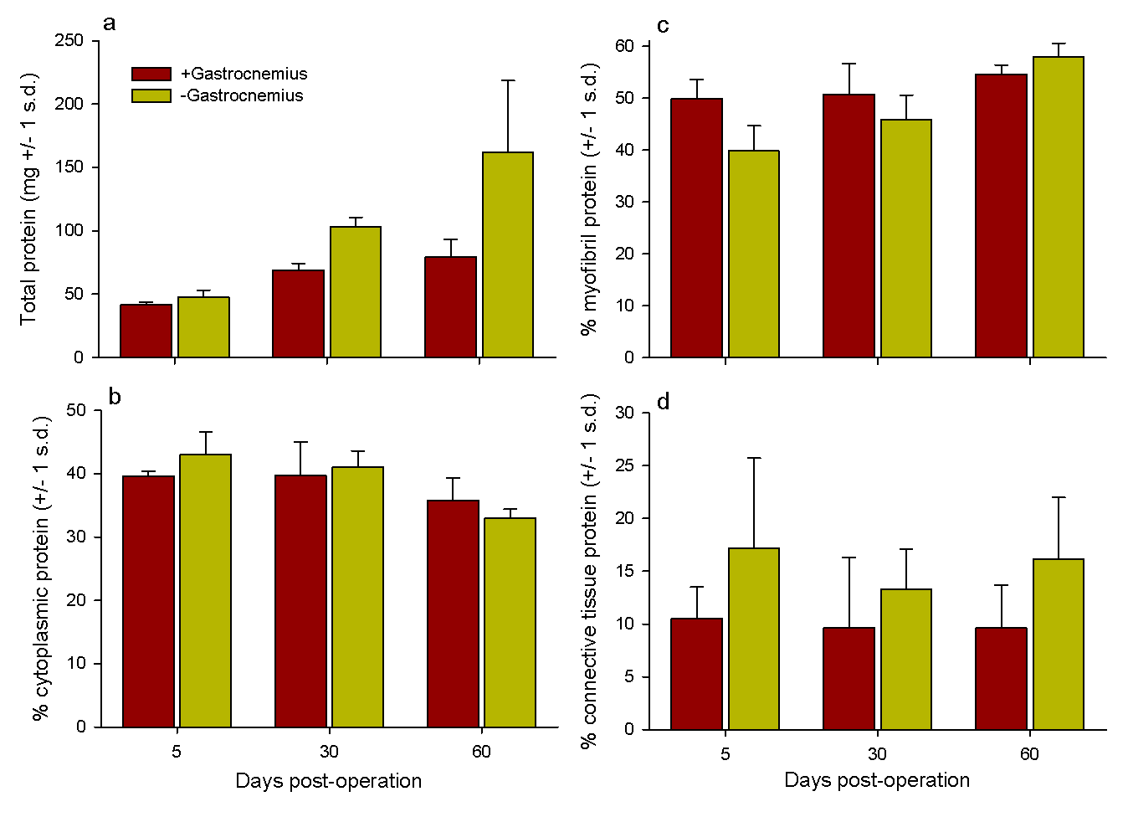
Figure 13.22
Notes:
Figure 13.22 Effect of removal of the gastrocnemius muscle on the plantaris muscle in rats. a. Total protein mass. b. Percent protein found in muscle cell cytoplasm. c. Percent protein found in muscle cell myofibrils. d. Percent protein found in connective tissues.

Slide 31
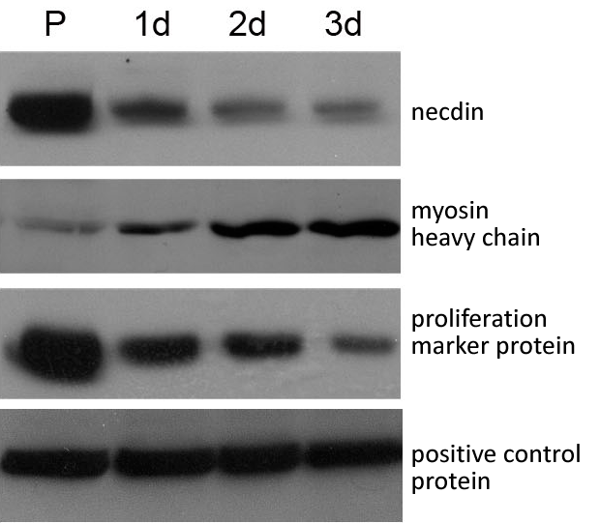
Figure 13.23
Notes:
Figure 13.23 Primary muscle precursor cells were isolated, maintained for 24 h in growth medium (P), or allowed to differentiate for 1, 2, or 3 days. Protein expression was analyzed using antibodies specific to each protein. The myosin heavy chain is a subunit of the myosin protein. A protein expressed in both stages was used as a positive control.

Slide 32
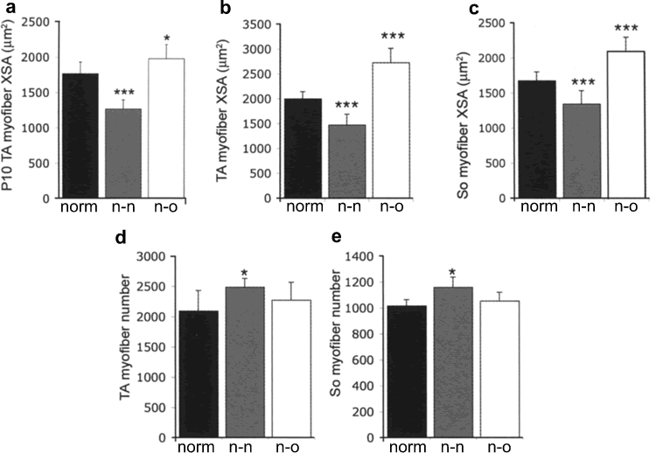
Figure 13.24
Notes:
Figure 13.24 Average myofibril cross-sectional area (XSA) for normal (norm), no-necdin (n-n), and necdin-overexpressing (n-o) mice of tibialis anterior (TA) muscle in 10 day old mice (a), TA in 60 day old mice (b), and soleus muscle (So) in 60 day old mice (c). Average number of myofibrils for normal (norm), no-necdin (n-n), and necdin-overexpressing (n-o) mice of TA (d) and So (e) in 60 day old mice. * = average is significantly different from the normal average (P < 0.05), and *** = average is highly significantly different from the normal average (P < 0.001).

Slide 33
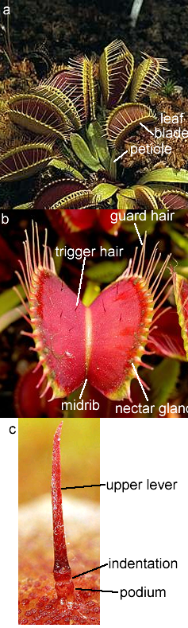
Figure 13.25
Notes:
Figure 13.25 The Venus flytrap (Dionaea muscipula) with multiple leaf traps (a) and close up of one leaf (b).

Slide 34
Figure 13.26
Notes:
Figure 13.26 This graph shows the action potentials and contraction of a Venus flytrap leaf in response to deflection of trigger hairs. The top trace is the action potential measured on an oscilloscope, and the bottom is the contraction measured with a force transducer. The heavy lines on the y-axis are 5 millivolt intervals and the heavy lines on the x-axis are 0.2 second intervals.

Slide 35
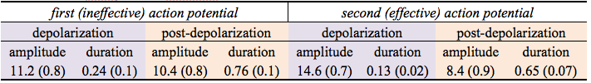
Table 13.6 Amplitude and duration of the first ineffective and second effective action potentials after stimulation of trigger hairs on Venus flytraps. Averages are for 31 separate leaves, and standard errors are in parentheses. Amplitude is in millivolts (mv) and duration is in milliseconds (msec).
Notes:
Table 13.6 Amplitude and duration of the first ineffective and second effective action potentials after stimulation of trigger hairs on Venus flytraps. Averages are for 31 separate leaves, and standard errors are in parentheses. Amplitude is in millivolts (mv) and duration is in milliseconds (msec).

Slide 36
Figure 13.27
Notes:
Figure 13.27 Sequence of Venus flytrap closure during electrical stimulation with a 14 μC charge and 1.5 V. Note the two electrodes located in a midrib (+) and in one of the lobes (−)

Slide 37
Figure 13.28
Notes:
Figure 13.28 Dependence of the distance between rims of lobes on injected charge using two Ag/AgCl electrodes located in a midrib (+) and in one of the lobes (−) and 3 μC charge was
injected to the same plant every 7 s. Capacitor was charged 1 s from 1.5 V battery.

Slide 38
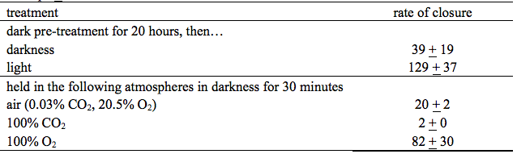
Table 13.7 Effect of various treatments on rate of trap closure in Venus flytraps after stimulation of trigger hairs. Rate of closure is in degrees per second. Numbers are averages for 20 traps + 1 standard deviation.
Notes:
Table 13.7 Effect of various treatments on rate of trap closure in Venus flytraps after stimulation of trigger hairs. Rate of closure is in degrees per second. Numbers are averages for 20 traps + 1 standard deviation.

